Slide 1
Emirates Airlines

Slide 2
Agenda
Introduce ACI and lay out why we are the best partner for them (5-10 minutes)
Engagement Model with customers (5-10 minutes)
ACI’s approach to Fraud Prevention (see commentary)
Operational support, Dispute management and Service level agreements (embedding into multi layers approach ?)
Demo (video)
Our experience in the airlines / travel industry
Q&A
Notes:
ACI’s approach to Fraud Prevention
Machine Learning -> 2-3 slides on our ML approach USING THEIR LANGUAGE from the email while answering all their needs.
Consortium Data -> 1 slide using their language from the email while answering all their needs
Profiling -> 1 slide time on file etc
Rules / Features -> No slide
Decisioning -> No slide
Supplemental Services -> 1 slide with all third parties supported
Business Analytics and reporting -> 1-2 slides Reports and Dashboards
Expert Risk Analyst -> 1-2
Finishing with Future proof of solution
From RFI response:
Future proof fraud platform for next 5 years
Machine Learning technology as a key source of fraud detection
Experience & Expertise in Airline Industry
NFRs
Partnership approach and strong support structure
From their latest email (what they want to see / want to have answers on)
Business and Engagement model with clients
Experience of working with airline and travel industry
achievements supported with performance indicators
customer recommendations with relevant case studies
Innovation and strategic direction
use of Machine Learning, Artificial intelligence, Behavioural analytics, Behavioural biometrics and Data science in decision making
collection, sharing and use of data sets related to various attributes of a customer genome
Operational support, Dispute management and Service level agreements
Reports and Dashboards

Slide 3
Agenda
Emirates Challenges & Industry Insights
About ACI and
KPIs – Best customer examples
Industry benchmarks & used cases
Solution Overview
System Architecture
Machine Learning
Risk analyst team as key differentiator
Demonstration

Slide 4
Emirates Requirements from RFI
Future proof fraud platform for next 5 years
Machine Learning technology as a key source of fraud detection
Experience & Expertise in Airline Industry
NFRs
Partnership approach and strong support structure

Slide 5
Emirates Airways – global leader in aviation
Awards
Stats
Employees
Flights
Revenue

Slide 6
Why ACI can deliver for Emirates
Experience with xxxx travel merchants on platfrom
NFRs with 99.999% uptime in 2019
Machine Learning with Continuous Learning Model deployment in Q1 2020
Flexibility with multi-layered approach to fraud management
Expertise through 17 certified risk analysts globally
Global Consortium fraud to…….
KPI Optimisation through Intuitive and Value-add User Interfaces for transaction review and business intellgence

Slide 7

ACI’s Global presence & ability to service Tier 1 companies
Support 18 of the top 20 banks worldwide
Support bill payment
needs of 3,500+ corporates
5,100+
organizations around
the world rely
on ACI solutions
Serve thousands of merchants directly and through payment service providers
Prevent fraud for
1,500+ banks, intermediaries and merchants
Americas
4,600+
customers
EMEA
400+
customers
Asia/Pacific
200+
customers

Slide 8
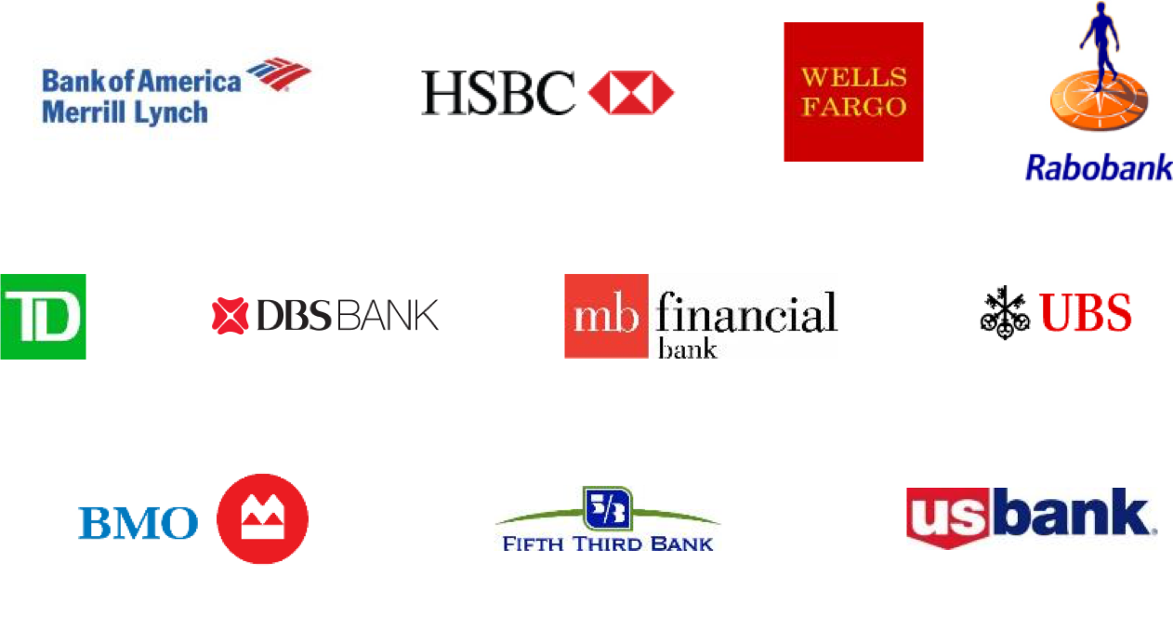
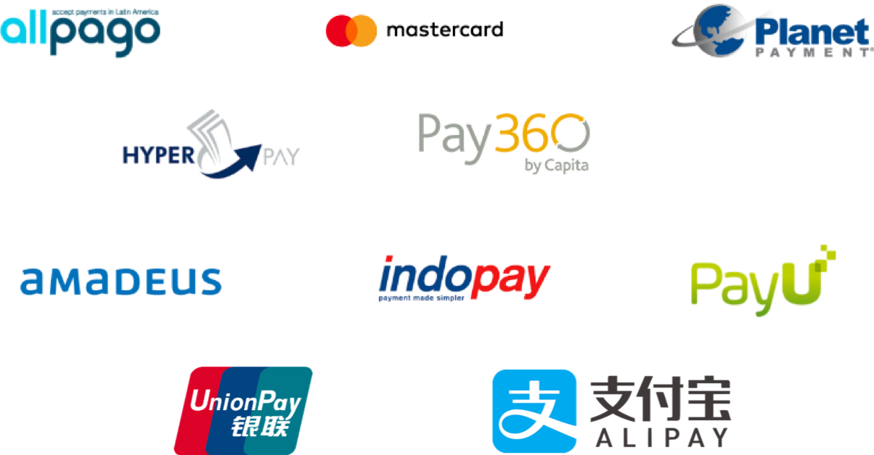


ACI support the some of the world largest brands

Slide 9
Mission-Critical, Payments-Grade Software
Trust ACI to deliver quality you can rely on
Capacity
End-to-end concurrent payment processing with high reliability and predictable resource consumption
Availability
Accepting and processing payments all the time
Serviceability
Skillful management practices, processes and systems resulting in an operationally excellent and scalable enterprise
Scalability
Cost to operate per transaction is consistent regardless of scale
Security
Authenticating, authorizing and auditing all interactions in the end-to-end payments ecosystem
Globality
The ability to work with existing and new payment networks all around the world with ever-decreasing cost
Through these quality characteristics, we deliver a best-in-class customer experience.

Slide 10
KPIs – customer examples & awards

Slide 11


Awards and Accolades
Security Innovation of the Year 2018 Awarded to ACI for the real-time fraud management and adaptive machine learning capabilities of its payments risk management solutions.
Best ID, Security and Anti-Fraud Solution 2018 International Award 2017 UP® eCommerce Payments™ solution
“ACI ReD Shield helped turn a $4M annual fraud loss into a less than $250K annual fraud loss over the last four years. It allowed us to implement an automated fraud prevention program without having to create a manual review team and process.”
IT Systems Analyst, Large Enterprise Food Company
“With implementation of the product level detail, we’ve been able to stop over 95% of losses on our high-risk products. We’ve seen our chargebacks fall dramatically.”
Fraud Analyst, Large Retailer
“The ACI risk analyst team are complete rock stars and incredibly talented. We would be lost without them.”
Director of Fraud, Large Enterprise Consumer Products Company
TVID: 379-19C-F50
TVID: 63C-C96-67C.
TVID: D47-52C-E8D

Slide 12




ACI ReD Shield® Case Studies
REPLACE CREW CLOTHING WITH JAL
OR FIJI AIRWAYS
The results!
Crew Clothing
Aegean Airlines
Voyages-SNCF
Reduced deny rate by 12% to 3%
Over the first 12 months of the contract, ACI helped stop 97% of confirmed fraud, saving over €3,000,000
Over the last 3 years reduced fraud rate on both domestic and cross-border transactions by 66%, delivering a smoother customer experience and protecting brand reputation
Reduced fraud rate from 1% to 0.5%

Slide 13
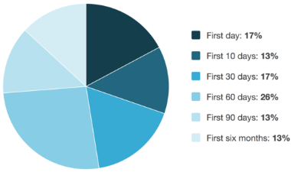
Don’t Take Our Word for It
ACI Red Shield® customer research
Note: 7 people answered “I don’t know/not applicable.” Their responses have been excluded from this chart, and from the sample size.
How long after you deployed the solution did you begin seeing fraud management benefits? (i.e., reductions in losses, improvements in efficiency/resources or both)?
OUT OF 23 ACI customers surveyed
47% of customers experienced fraud management benefits from ACI Red Shield in the first 30 days
73% in the first 60 days
86% in the first 90 days
100% saw benefit in the first 6 months
Source: TechValidate survey of 23 users of ACI ReD Shield.

Slide 14








Experience
For the last several months ReD Shield decisioned 16% or 94M by volume or 27% or $18B payment transactions, which doesn’t include event decisioning.
Average Transaction Value(ATV) of Travel – Overall $19
Average Transaction Value (ATV) within Travel – Airline is $60
Average Transaction Value (ATV) within Travel – Agency is $436
1% or 899K by volume or 3% or $484M is fraud detected, with a low average ticket value of $38 which has reduced as a number of clients have experienced a increase in card testing on their site more often trainlines.

Slide 15
Production Results from the New Technology – Singapore Air
Supporting business growth in real time on ACI ReD Shield
Our KPIs for Merchant Business Empowerment and Risk Management
Full transparency of all KPIs
Of all 34% are canceled
Market avg.
ACI avg.
Challenges – Can be decisioned automatically using automated data authentication capabilities and features.

Slide 16
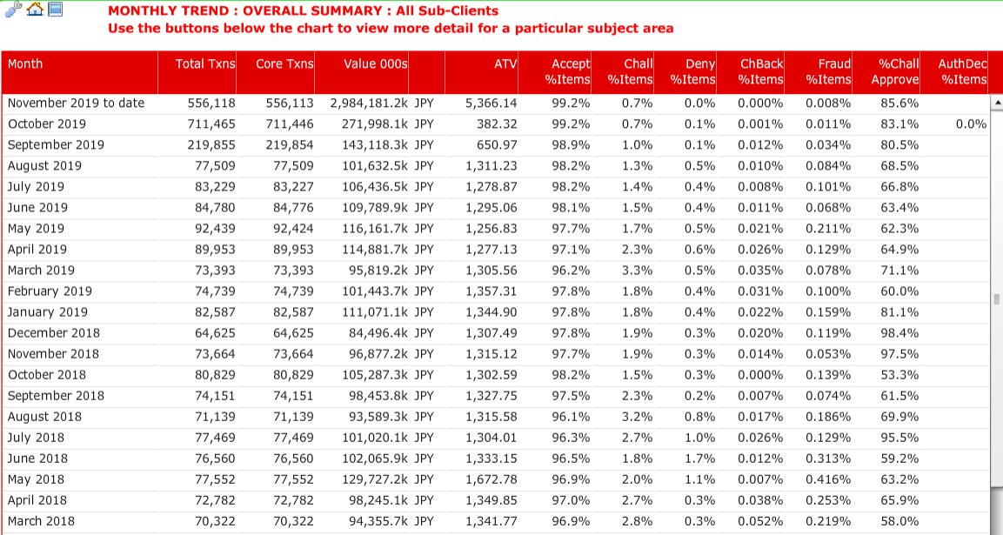
Production Results from the New Technology
ACI delivered uplift in approval rate from
96.9%
to
98.11%
with
0.01% chargebacks
on
International Traffic

Slide 17
Consortium Approach to Travel
Model performance use case – Travel
ABOUT
CHALLENGE
SOLUTION
Leverage collective fraud data across multiple travel clients from the airline, train, hotel and online travel agents (OTA) verticals
Evaluating approximately 25 million accounts, more than 50 million transactions and over 120,000 fraudulent transactions
Travel purchases tend to have higher average transaction values (e.g., plane tickets, train tickets, hotel stays, travel/vacation packages, etc.) with lower frequency
Average fraud loss is $500 per transaction
Sector model designed to identify high-value transaction types
Pooling of travel data facilitates a stronger detection system across this sector
Travel sector model false positive rate is 12:1
Model detected more than 45% of fraudulent transactions
Fraud amount alerted 60% total fraud loss
More than US$35M fraud losses detected
RESULTS
Notes:
Based on ReD Shield "Travel" Consortium Data

Slide 18
Travel merchants using Red Shield
CIARA TO ADD LOGOS BASED ON ERIKA LIST

Slide 19
Customer Support Structure & Global Risk Team

Slide 20
ACI Teams to support Emirates
Team | Role
Customer Success Manager (Matt Rubin)
Primary Risk Analyst (Craig Jones)
Primary Modelling Lead (Jimmy Hennessy)
Solution Consultant (Kieran Mongey)
Implementation Manager (Dan Tillson)
Project Manager (Mohammed Ali)
Executive Sponsor (Fabian Gloerfeld)

Slide 21
Risk Analysts
Certified eCommerce fraud prevention professionals:
Subject matter experts in payments and in the fraud space through professional and managerial references
Expertise through the publishing of their work in a public domain or by speaking at a recognized event on CNP fraud, electronic payments or online security
Completion of 16 courses that include core fraud operational procedures, core fraud strategy and solution methodologies
Average of seven years at ACI
Advanced education in machine learning/predictive modeling, analytics and statistics
Assigned a base of accounts that best fit their existing merchant portfolio
Will become an extension of merchant payment / fraud team
Deliver value-add insights into Industry Trends and Platform Optimization
Build strong relationships together with wider ACI Customer Success & Help 24 teams

Slide 22

Global Hosted Risk Services – Reach and Scale
Certified eCommerce Fraud Professionals
17 Supported Languages
Hosted Application, Global Service
22 Analyst Globally
Supporting many Accounts
South West - London
New Jersey
Mumbai
Singapore
Sao Paulo
Analyst locations
Sydney
Follow-the-Sun Support

Slide 23
Current: Global Structure of Risk Services – Hosted
Director of Americas –
Shyam Shah
VP Global Erika Dietrich – (U.S. Based)
Desiree Leverich
Steven Ng
Manager of Risk EMEA –
Julia Roberts
Jennifer Fox
Nick Sarris
Whitney Henry
Manager of APAC –
Kerrie Sherwood
Ashley Wilson
Craig Jones
Brian Siao
Cyrus Mwangi
Renee Tu
Willa Jiang
Sharell Barshishat
Pat Hengeveld
Clement Kan – Singapore
Raheel Ahmad
Samar Shah
Nandkishor Rajak –
Mumbai
Daniel Tressi –
São Paulo
Average employee tenure is seven years
13 certified eCommerce fraud professionals
Degrees in computer/data sciences, computer information systems, mathematics and actuarial science
17 languages spoken

Slide 24
Solution Overview

Slide 25
ACI ReD Shield® – Fraud Prevention and Detection – By Design
Accuracy
Pinpoints fraud
Exposes emerging trends
Connects customers to ACI risk analysts
Efficiency
Reduces losses
Enables customers to scale up
Powers continuous detection
Growth
Optimizes accept rates
Drives revenue and loyalty
Enables safe expansion
ACI will work with every client to ensure the solution works for their business, vertical and geography
Follow the guidance, and this fraud tool will out-perform the competition

Slide 26
Fraud Prevention and Detection, Powered by ACI ReD Shield
Our multiple layers of control speak for themselves
Machine Learning Pattern recognition Client specific and sector models
Profiling Enhanced detection, increased acceptance
Consortium Data Shared global fraud intelligence for rapid response to related fraud trends
Rules / Features Simple accept/deny or sophisticated rulesets, tailored by product, sector, channel and country; real-time rule manager; silent rules for testing
Decisioning Automated decisioning; real-time and retrospective screening
Supplementary Services Easy callout to specialist third-party services as required
Business Analytics and Reporting Near-real-time and historic view for performance management and reporting
Expert Risk Analyst Fraud strategies, risk reviews, real-time support from analysts with sector expertise
Minimal technical setup, rapid go-live, managed by users through ACI’s Control Center

Slide 27

Layer 1 – Machine Learning
Layer 1 – Machine Learning
Pattern recognition, client-specific and sector models
Pattern recognition, client-specific and sector models
120 years of data science experience across an eight- person team
General, sector-specific and bespoke models
7:1 false positive rate using sector model alone
60% of $ fraud losses alerted
Proactive learning models – currently in the process of being patented
POC successfully tested in 2019, on target for 2020 release
More than 1,000 customers (Merchants and Issuers) help us build domain-specific models
Over 7,500 features available

Slide 28
Layer 1 – Machine Learning
Layer 2 – Profiling
Enhanced detection increased acceptance
Pattern recognition, client-specific and sector models
We add more than 14.5M data elements per day into profile results
Financial results – case study
$2.5M saved through reduction in manual reviews – in one month
Conversation results – case study
59% uplift during peak = $245k per month added revenue
additional $100k monthly fraud savings
Performance results – case study
28% reduction in volume of reviews

Slide 29
Layer 1 – Machine Learning
Layer 3 – Consortium Data
Shared global fraud intelligence for rapid response to related fraud trends
Pattern recognition, client-specific and sector models
850+ merchants around the world contribute to the Consortium
10,000+ fraudulent data points collected daily
2M+ decisioned transactions daily with a value in excess of $230M
10M+ fraud records within our Consortium history

Slide 30
Layer 1 – Machine Learning
Layer 4 – Rules
Simple accept/deny or sophisticated tailored rule sets tailored by product, sector, channel and country
Pattern recognition, client-specific and sector models
Rule Manager
Flexible rules across all channels
Feature Manager
Create and manage features (complex calculations) for use in rules
List Manager
Create or import lists for use in rules
Stream Analytics Engine
Real-time features stored and retrieved when triggered by an incoming transaction
Batch Analytics Engine
Initializes new time-based features by using historic data stored within the Hadoop cluster for use in rules, and view in the CSI and ACI ReDi™
Supports ReD Shield fraud detection across a myriad of fraud types

Slide 31
Layer 1 – Machine Learning
Layer 5 – Decisioning
Automated decisioning; real-time and retrospective screening
Pattern recognition, client-specific and sector models
Customer Service Interface
Displays results of real-time analysis and decisioning
Searchable, interactive, actionable for pro-active attention to real time decisions
Retrospective Screening
Associate newly identified fraud intelligence to recently accepted transactions
Up to 30-day reduction in identifying possible frauds
Proactively cancel order / perform refunds / retrieve goods from the van
Silent Rules
Test rules before promoting them to production – monitor 'what would happen' if the rule was live
Multiple risk strategies:
Accept/Deny
Accept/Challenge/Deny
Active/Passive
Enhanced Responses available for use within merchant's own solutions

Slide 32
Layer 1 – Machine Learning
Layer 6 – Supplementary Services
Easy callout to specialist third-party services as required
Pattern recognition, client-specific and sector models
Best in class 3rd party value add services to enhance fraud detection and reduce false positives
– e.g. Device ‘fingerprint’ or IP Geolocation services
+ outsourced services such as Manual Reviews and Chargeback Management
Simple, fast-enablement to run:
in real-time against 100% of transactions,
or by sub-client,
or as-needed triggered using Auto Analyst
or ad-hoc as part of a manual review
Eliminates the need to manage multiple vendor relationships
Single contract through ACI
UP eCommerce Payments Platform – fully integrated to the ACI PAY.ON Payments Gateway

Slide 33
Layer 1 – Machine Learning
Layer 7 – Business Analytics and Reporting
Near real-time and historic view for performance management and reporting
Pattern recognition, client-specific and sector models
BI tool that provides visibility into received, gathered and generated data
e.g. transaction, order basket, rule and blacklist hits
We add value to this data -
Multiple currency values; multiple time zone values; risk markers; code translations
- ready for immediate use in one place
We add post real-time updates to the original transactions
– e.g. merchant approvals/ rejections, fraud identification, chargebacks
to complete the ‘transaction journey’
Continuous monitoring to spot:
trends; new fraud attacks; errors in strategies; profiling intelligence; review-agent training needs; silent rule performance; KPI monitoring and more

Slide 34
Layer 1 – Machine Learning
Layer 8 – Expert Risk Analysts
Fraud strategies, risk reviews, real-time support from analysts with sector expertise
Pattern recognition, client-specific and sector models
Works with the merchant for the lifecycle of the contract
Optimize KPIs
Deep relationship with assigned merchants
Often seen as a partnership with the merchant’s fraud team
17 languages are supported
The team operates on a ‘follow the sun’ principle
Certified eCommerce fraud professionals
900+ individual service reviews conducted annually
Adding global insight into developing fraud trends

Slide 35
The Power of the Multi-Layered Approach
5% Business Rules
4% Email
Consortium data utilizes profiling capabilities applied across global transactional data and known fraud intelligence.
17% Velocity
5% Address Verification Service
6% IP Geolocation
Consortium data should be one feature of several features used within a successful fraud strategy.
10% Device ID
18% Model
Combination of approaches/tools provides best results to minimize false positives and increase conversion.
11% Consortium Data
14% Pattern
10% Purchase Behavior

Slide 36
The Power of the Multi-Layered Approach
Machine Learning Pattern recognition Client specific and sector models
Deny where > 3 Cards per email in 24 hours and IP country <> card country and machine learning score > 750 and card history < 3 days and email (ACI ReD Shield) < 10 days and device = mobile and origin = LONDON and booking class = G
Consortium Data Shred global fraud intelligence for rapid response to related fraud trends
Efficiency and effectiveness managed through:
Rule Manager delivers immediate changes [flexibility]
Consortium data tracks rule against emerging fraud [false positives]
ACI ReDi dashboards rule performance 24/7 [control]
Silent option allows for testing and offline monitoring [optimizing approval rates]
Risk team able to support platform performance [support]
RFX will alert on fraud that was subsequently approved [reduce exposure]
Machine learning will adapt to new trends [artificial intelligence]
Data mapping and profiling will highlight key data areas of risk ([data/consumer intelligence]
CSI will enable visibility of linked analysis and blacklisting [scope of fraud/immediacy]
Device fingerprint will help define transaction source [data]

Slide 37
Machine Learning at ACI

Slide 38
Machine Learning

Slide 39
Machine Learning

Slide 40
Machine Learning

Slide 41
Machine Learning

Slide 42
Machine Learning

Slide 43
Machine Learning

Slide 44
Transaction Flows, Architecture & Innovation

Slide 45
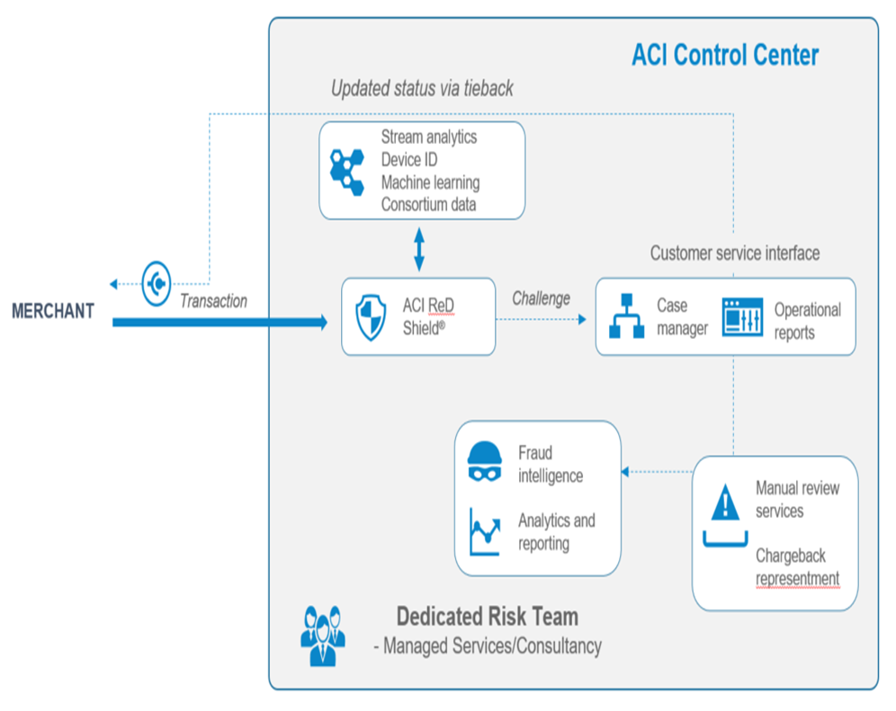

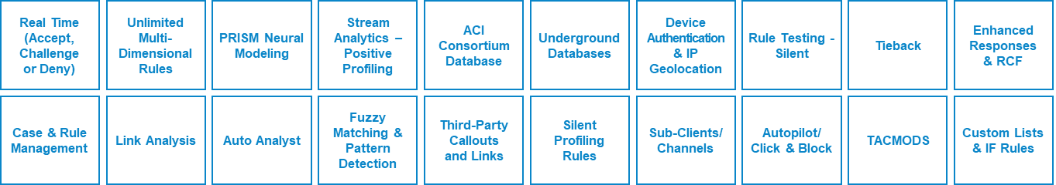
Platform workflow
ACI RED SHIELD MODULES

Slide 46
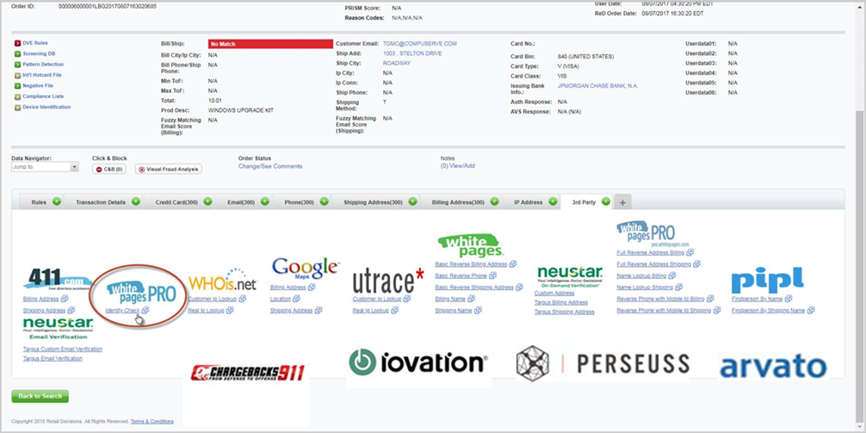
Customer Service Interface – manual review portal

Slide 47
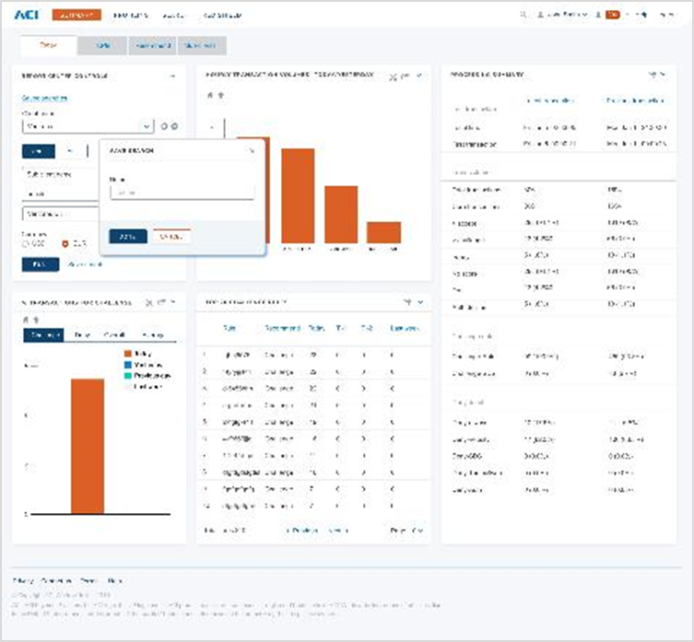
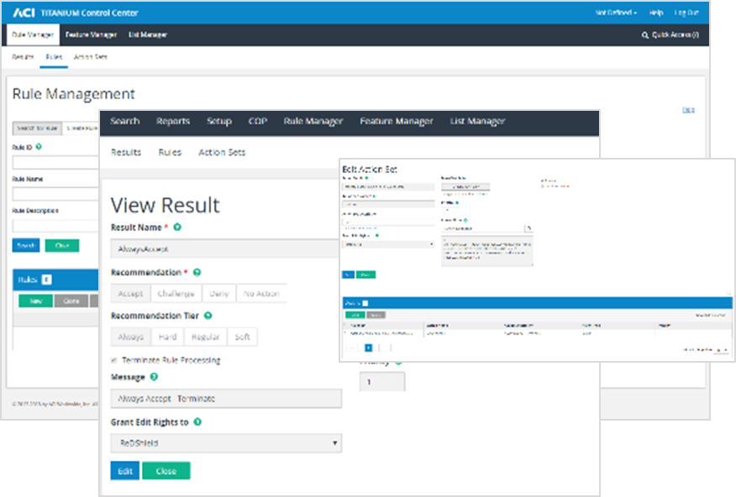
Business Intelligence at the heart of the platform

Slide 48
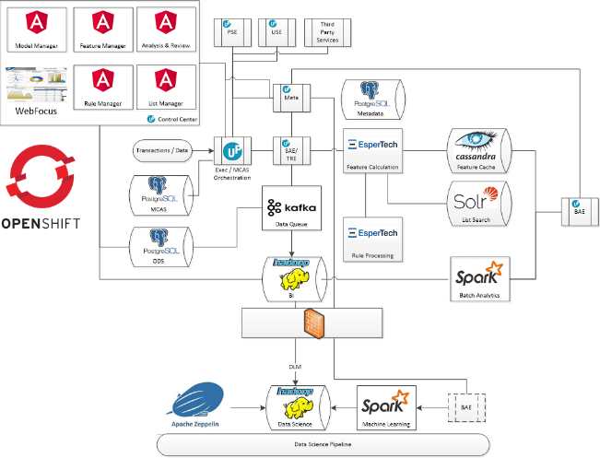
Latest technology drives NFRs & detection accuracy
Modern architecture
Container-based
Cloud-ready
Elasticity
Ready to meet your demands
Quick value delivery
ACI own data centers
Notes:
Delivered in the cloud – supported by a dedicated risk team. This describes the flow of a transaction.
Please note that there are many different modules being called for every transaction and depending on risk each is customised per merchant
At a very high level:
ReD Shield = Real Time decision is made
CSI = allows review agents to view a single transaction that may have a high possibility of fraud (it is then reviewed and manually moved to decline or accept (can be automated via TIEBACK)
Third Party = IP Geolocation, Device Fingerprint, Consortium database, Prism model are the main call-outs (some are ACI inhouse and some are third party calls and require additional work
ReDi = Where all KPIs are managed via dashboards, reportings and ability to drill into transaction data CRITICAL FOR OPTIMISING THE STRATEGY. Most important module!!!!
RFX = Where a transaction that was previously screened is alerted if it now matches a fraud data point. Sits within ReDi and differentiator for ACI
The diagram that animates at the bottom summarises how the platform delivers results across a timeline – NOT JUST RELATIME. Please refer to each deliverable in ORANGE (self explanatory)

Slide 49
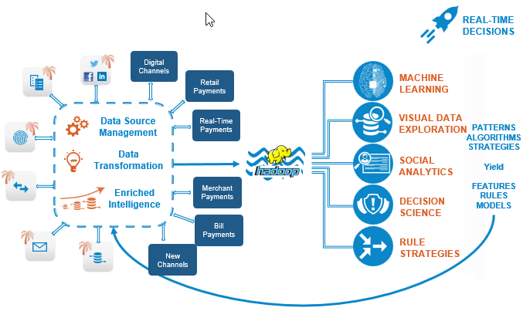
Latest technology drives NFRs & detection accuracy

Slide 50









Roadmap focus – solution overview
Partners
UP® Payments Risk Management™ and Risk Orchestration
Clients/ Segments
Authentication
Risk Services
Deployment Options
Data Providers
Challenge
Alert management
Synthetic ID
Case management
DeviceID
Rule manager
On-premise
Bank/Issuer
Email
Model manager
Service Providers
Biometric
BI/reporting/dashboards
Mobile
ACI Proactive Risk Manager™
Stream analytics (CEP)
Batch analytics
Processor/ Intermediary
SMS/Whatsapp
Case Management
Model execution
Capabilities
Cloud
ACI ReD Shield®
AML
Universal scoring engine (ML)
PRISM scoring engine (ML)
Merchant
Third-Party Data
Rules/analytics data store (Esper, Cassandra, Gemfire)
External Data
Consortium
Big data repository (Hadoop)
ReDi

Slide 51
Strategy optimization & use cases

Slide 52
Detecting Different Types of Fraud; Channels – Transactional or Event
Common Types of Fraud Detected in Travel Sector:
Account takeover
Sleeper accounts
Re-ticketing fraud
Velocity attacks or identity testing
Loyalty Fraud
Mileage Fraud
Reseller / Triangulation Fraud

Slide 53
Strategy Optimisation within Airline sector
Travel and Transit Strategy Optimization
Profiling
Know good customer behavior and safeguard VIP customers
Consortium data
Leverage global good and bad data points for black/whitelisting
Reporting in ACI ReDi
Near-real-time access to all KPIs that drive risk and inefficiencies in process
List management
Ensure custom lists are implemented on all data points
Machine learning
Utilize intelligence and profiling from ML model technology

Slide 54
Areas of focus – Airline Loyalty / Mileage Fraud
How to control use of LOYALTY within the fraud strategy
Profiling
Know good customer behavior and safeguard VIP customers and profile common good / bad trends in loyalty
Silent Rules
Track loyalty through SILENT RULES and gain immediate insights into consumer loyalty behaviour
Red Shield can screen any EVENT
Platform is payment agnostic so any transaction type can be monitored
Data Mapping
Monitor voucher code per email, device, IP or customer account. Add additional fields to rules to ensure low false positives. Push to reviews
Machine learning
Utilize intelligence and profiling from ML model technology. ACI (if financially feasible) can now build bespoke models

Slide 55
Types of rules proposed for Emirates
Based on project delivering strong Data Mapping to fraud engine (DMD)
CRAIG JONES TO SHOW STRONG AIRLINE SECTOR RULES FOR INTERNATIONAL AIRLINE
Should we use Features, Lists and New Rules in TRE OR Older DVE

Slide 56
Example service review for Airline customers
Anonoymised monthly review for Travel Sector
CRAIG JONES TO SHOW SLIDES OF STRONG SERVICE REVIEW
SHOW MARKET LEADING KPIS AND TRENDS ON FRAUD

Slide 57
Summary

Slide 58
Questions & Next Steps

